Slide 1
LINEAR ALGEBRA
Tim Dosen Pengampu
TM13 dan TM14

Slide 2
Orthogonality & Least Squares

Slide 3
Outline
[1] Inner Product, Length, & Orthogonality
[2] Orthogonal Sets
[3] Orthogonal Projections
[4] The Gram-Schmidt Process
[5] Least-Squares Problem

Slide 4
INNER PRODUCT, LENGTH, & ORTHOGONALITY

Slide 5
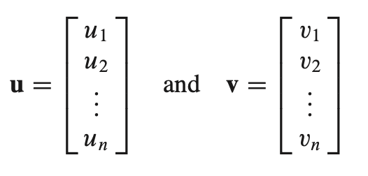
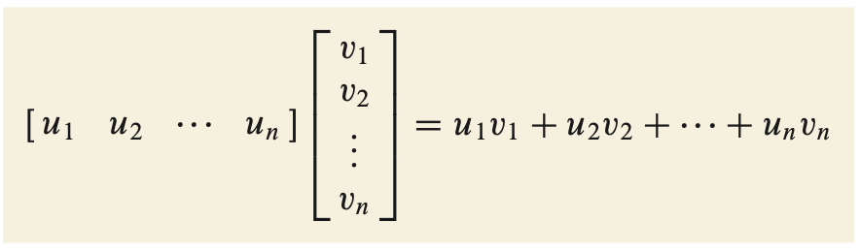
INNER PRODUCT
If u and v are vectors in $ℜn$
Then the inner product of u and v is

Slide 6
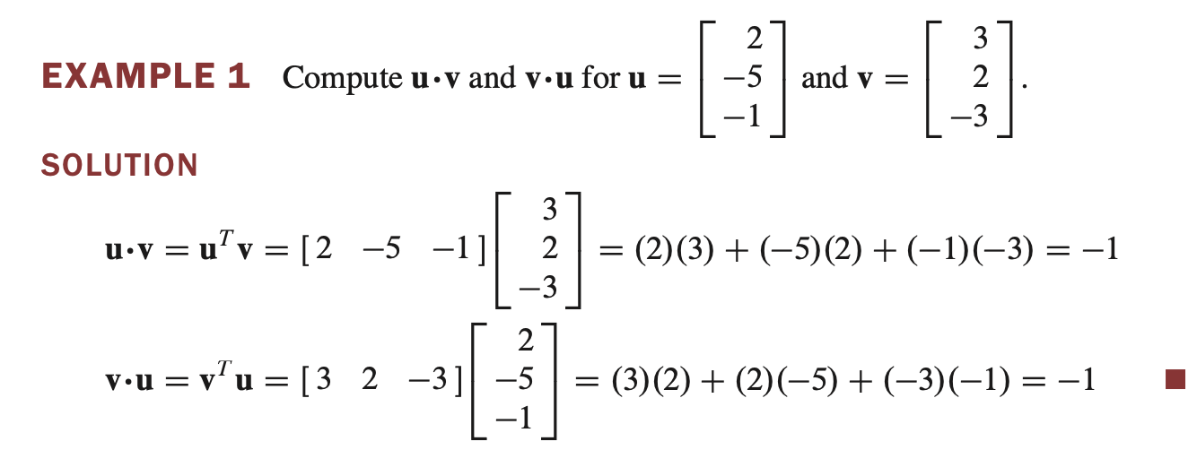
INNER PRODUCT

Slide 7
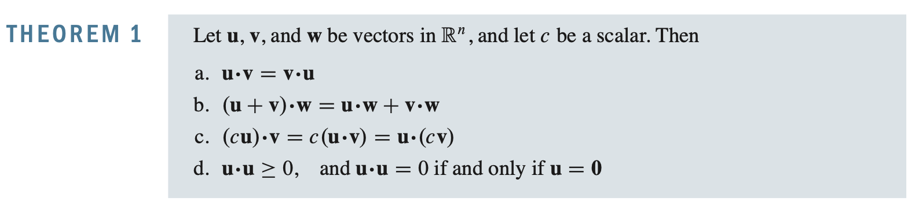
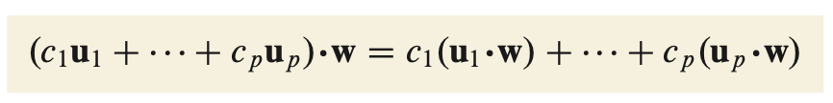
INNER PRODUCT
Properties (b) and (c) can be combined several times to produce the following useful rule:

Slide 8


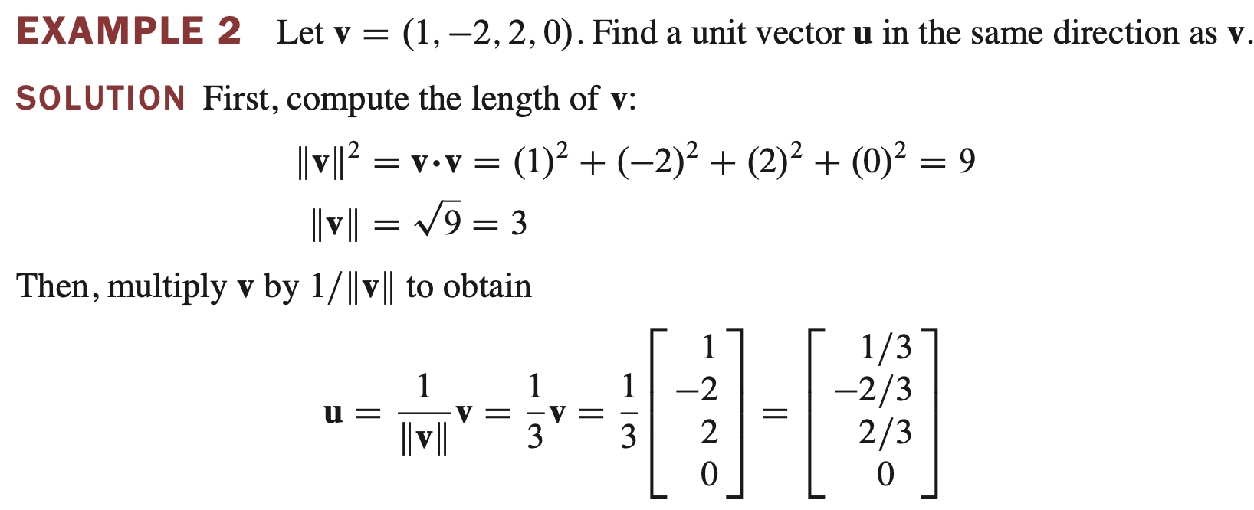
LENGTH
For any scalar c, the length of cv is |c| times the length of v. That is,

Slide 9
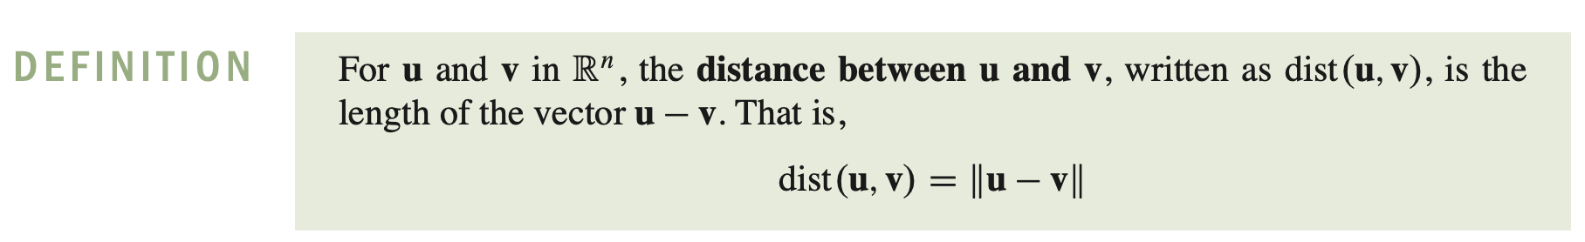
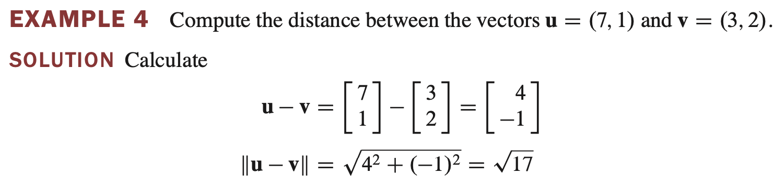
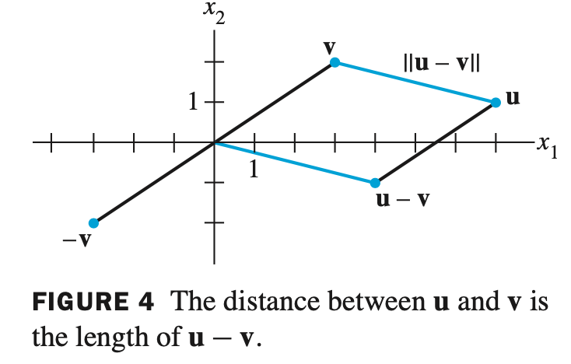
LENGTH

Slide 10
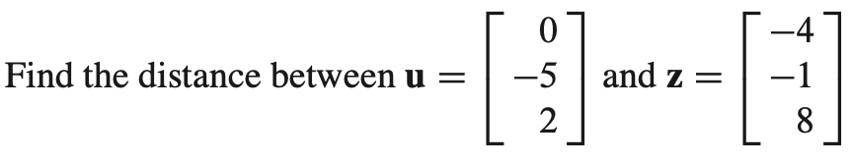
Latihan :

Slide 11
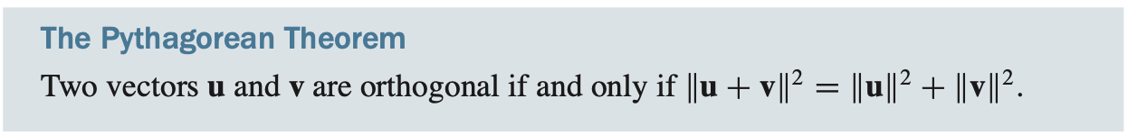
Orthogonality

Slide 12
ORTHOGONAL SETS

Slide 13

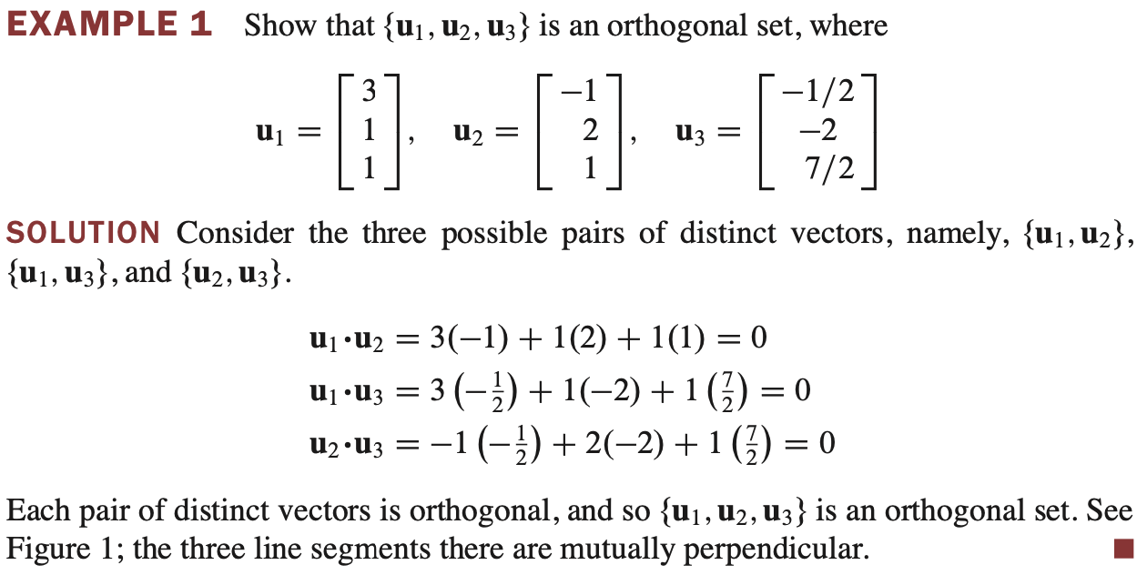
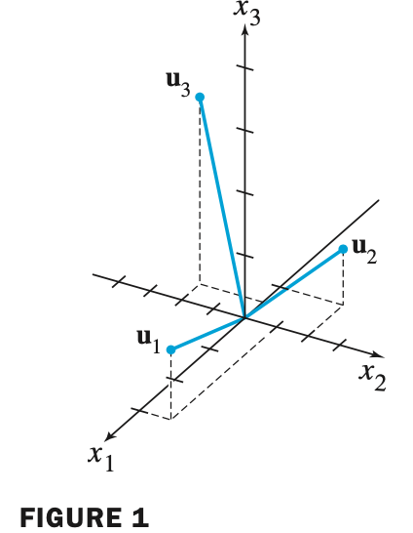
Orthogonal Set

Slide 14
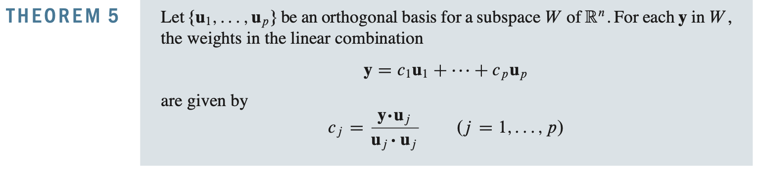
Orthogonal Set

Slide 15
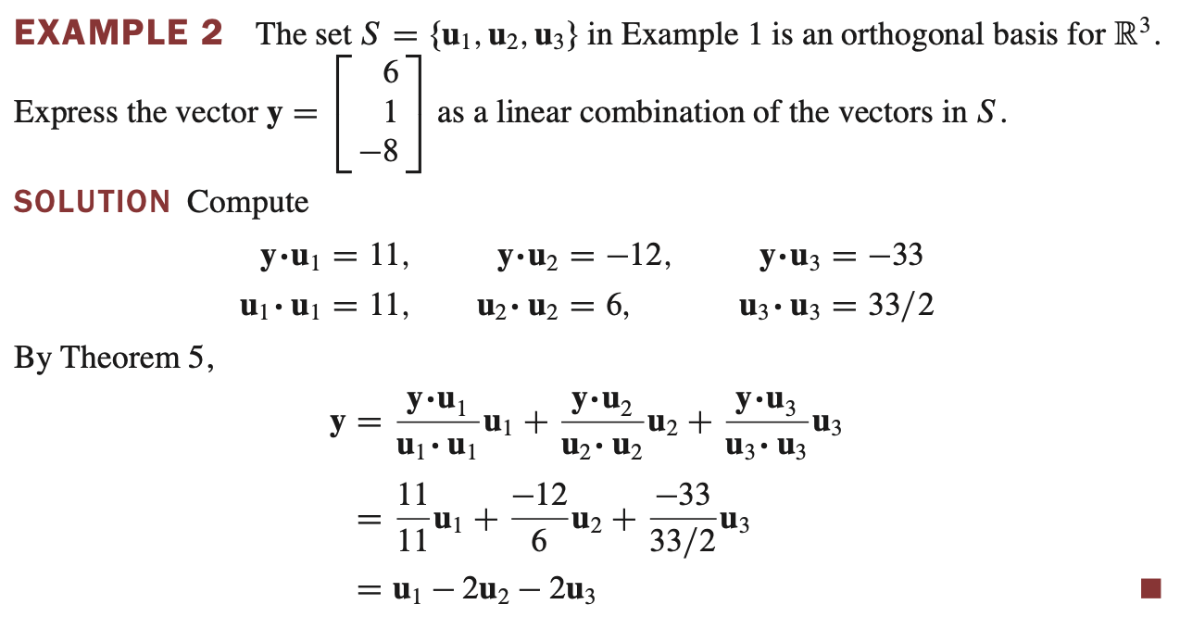
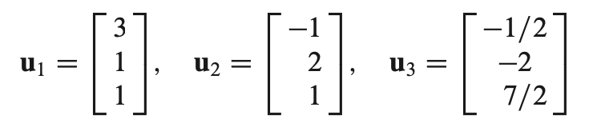
Orthogonal Set

Slide 16
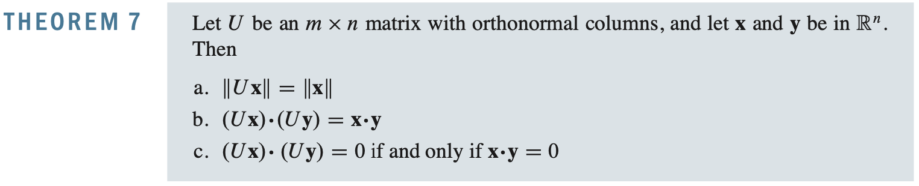
Orthonormal Set

Slide 17
THE GRAM-SCHMIDT PROCESS

Slide 18
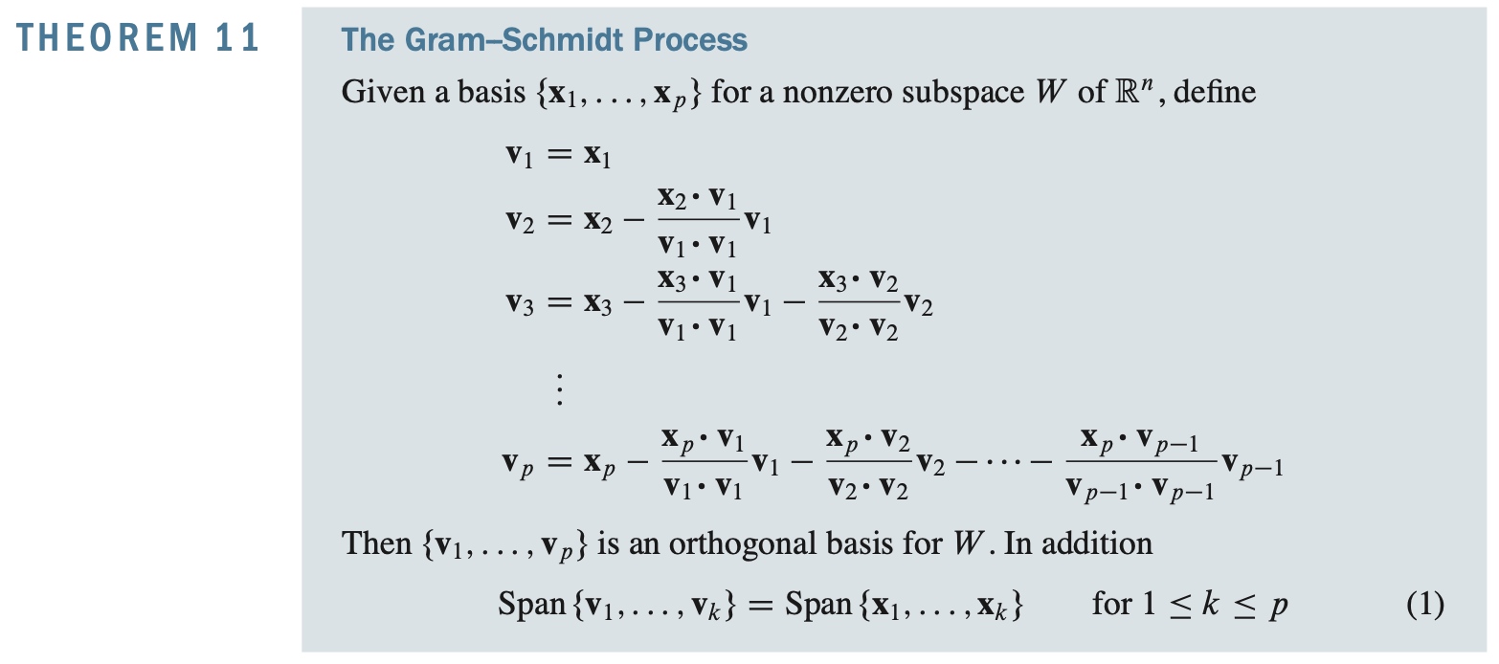

The Gram–Schmidt Process
The Gram–Schmidt process is a simple algorithm for producing an orthogonal or orthonormal basis for any nonzero subspace of $ℝn$

Slide 19
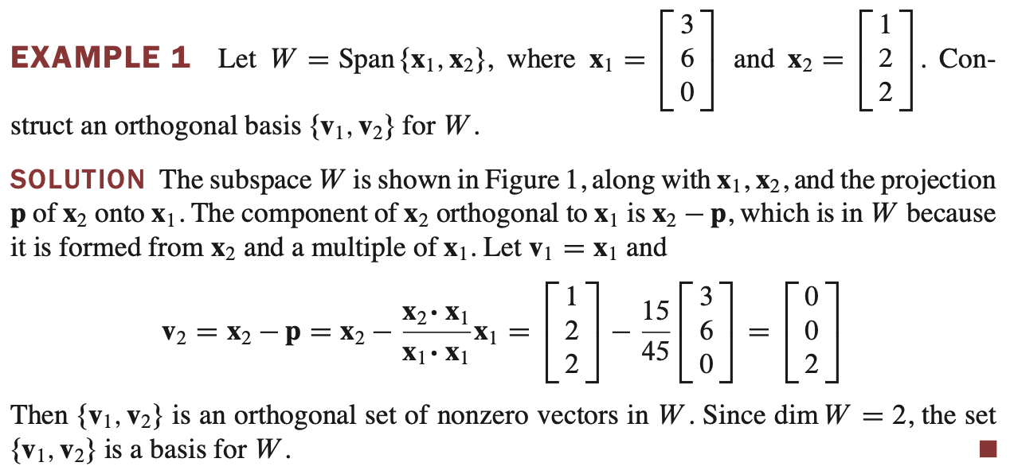
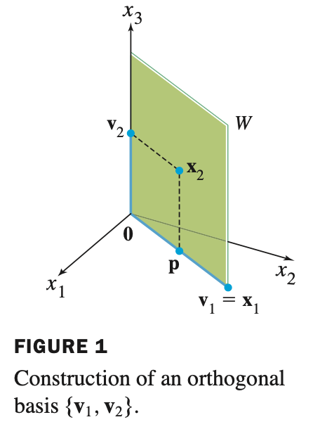
The Gram–Schmidt Process

Slide 20
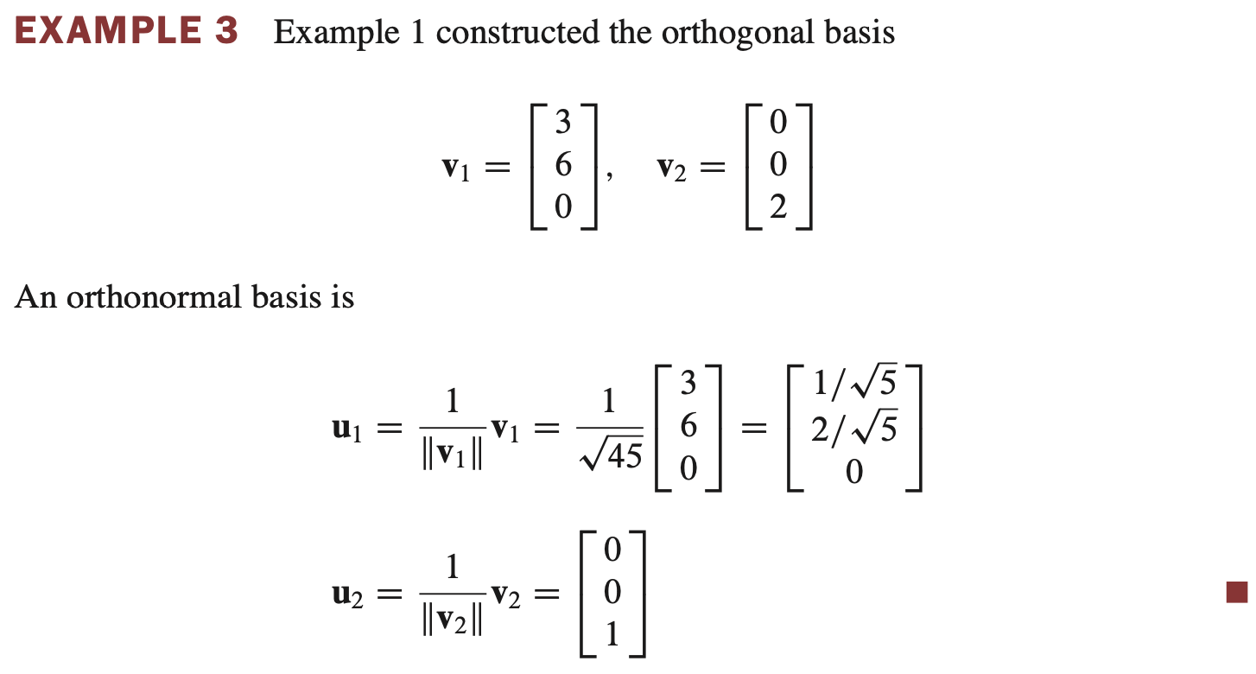
Orthonormal Bases
An orthonormal basis is constructed easily from an orthogonal basis {v₁, …, v_{p}}

Slide 21
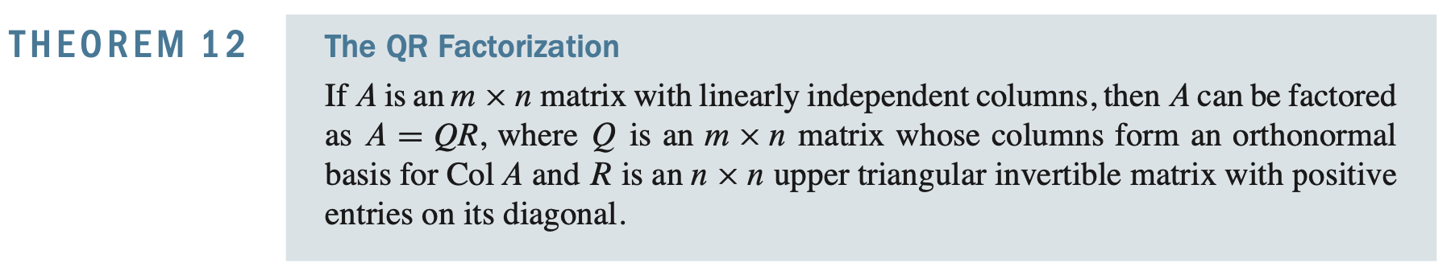
QR Factorization of Matrices

Slide 22

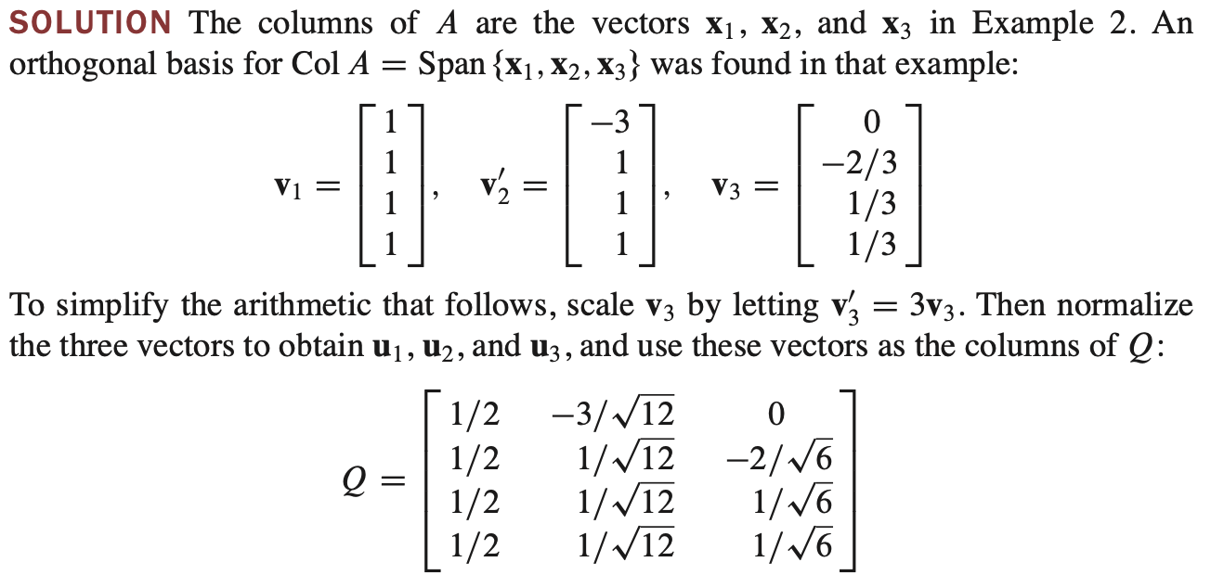
QR Factorization of Matrices

Slide 23
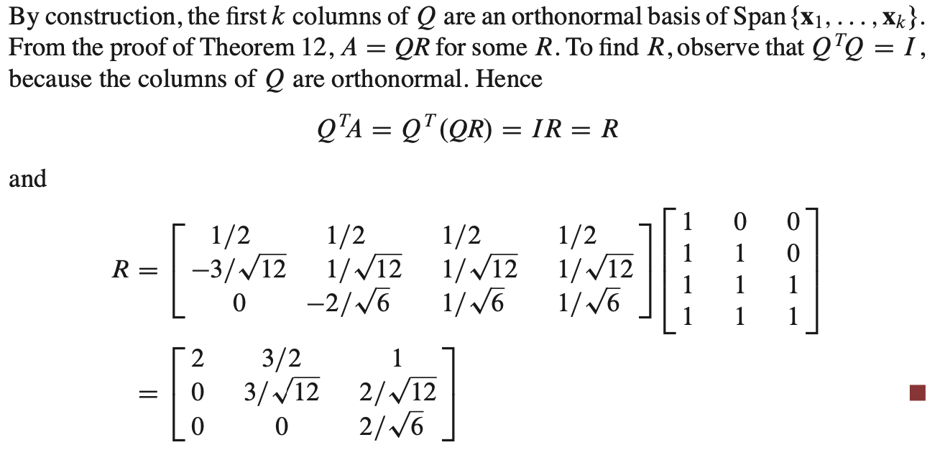
QR Factorization of Matrices

Slide 24
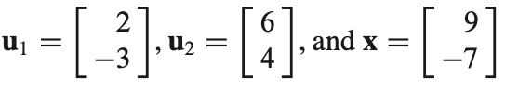
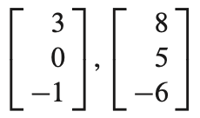
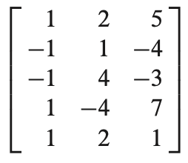
Latihan
1. Show that {u1, u2} is an orthogonal basis, Then express x as a linear combination of the u’s.
2. Use the Gram–Schmidt process to produce an orthogonal basis for W
3. Find a QR factorization of the matrix

Slide 25
LEAST-SQUARES PROBLEMS

Slide 26
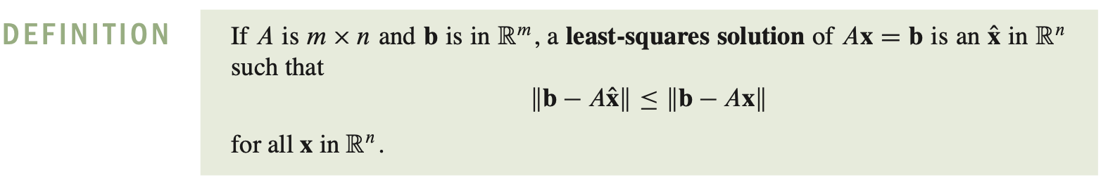
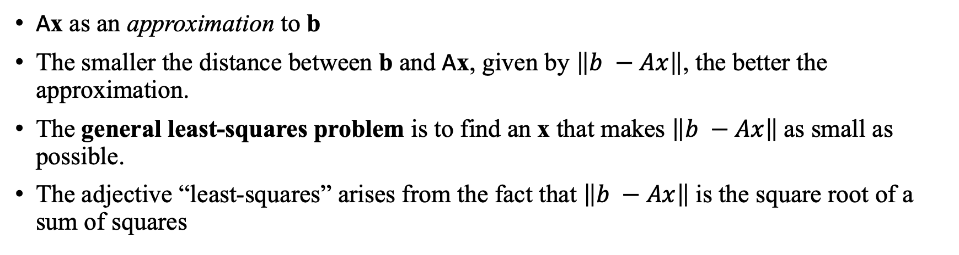
Least-Squares Problems
Ax as an approximation to b
The smaller the distance between b and Ax, given by $\left\|b −Ax\right\|$, the better the approximation.
The general least-squares problem is to find an x that makes $\left\|b −Ax\right\|$as small as possible.
The adjective “least-squares” arises from the fact that $\left\|b −Ax\right\|$is the square root of a sum of squares

Slide 27
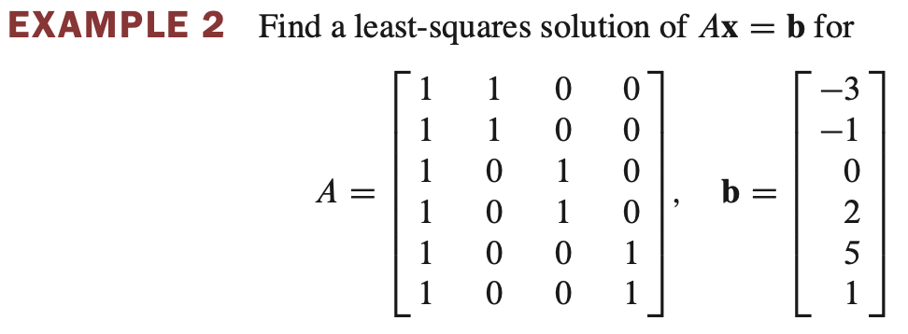
Least-Squares Problems

Slide 28
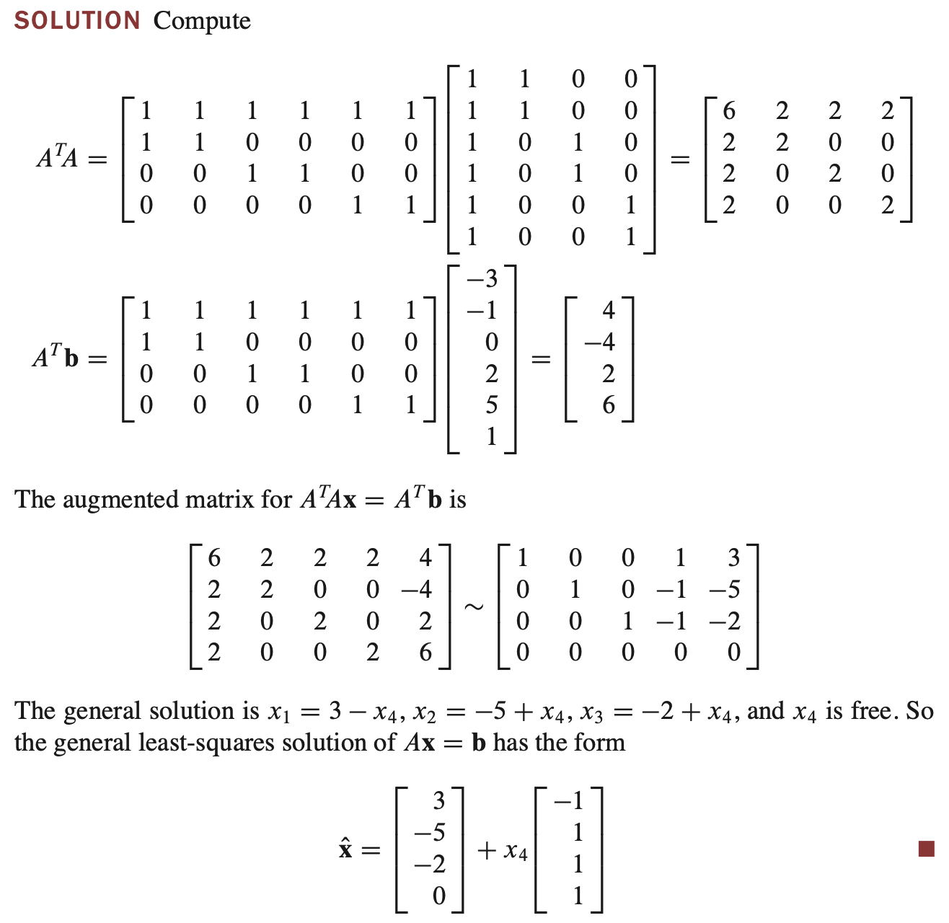
Least-Squares Problems

Slide 29
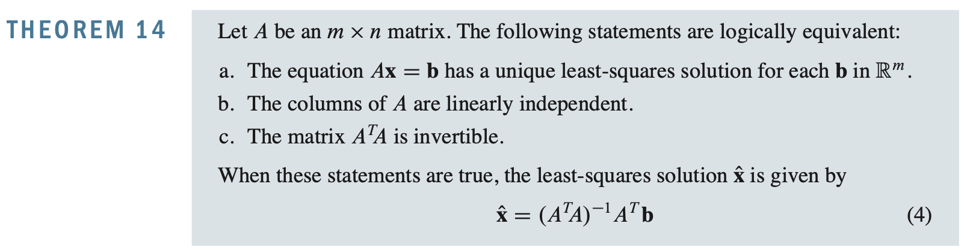
Least-Squares Problems

Slide 30
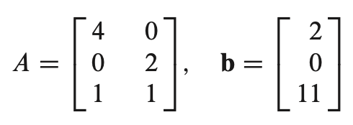
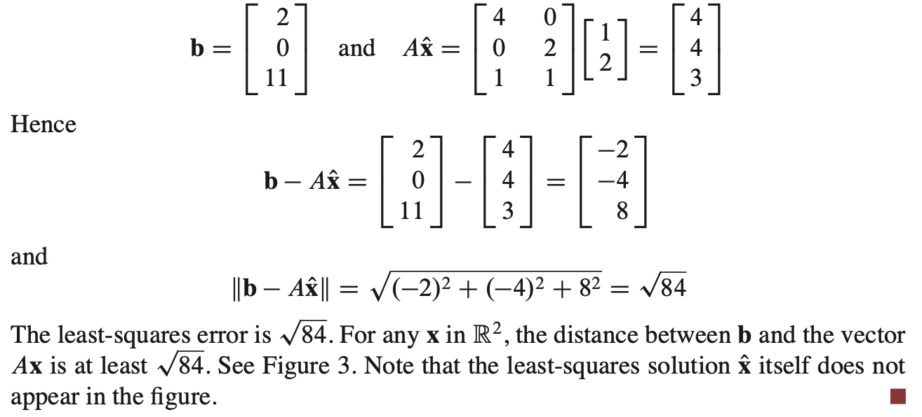
Least-Squares Problems
Example Determine the least-squares error in the least-squares solution of Ax = b
Solution:

Slide 31
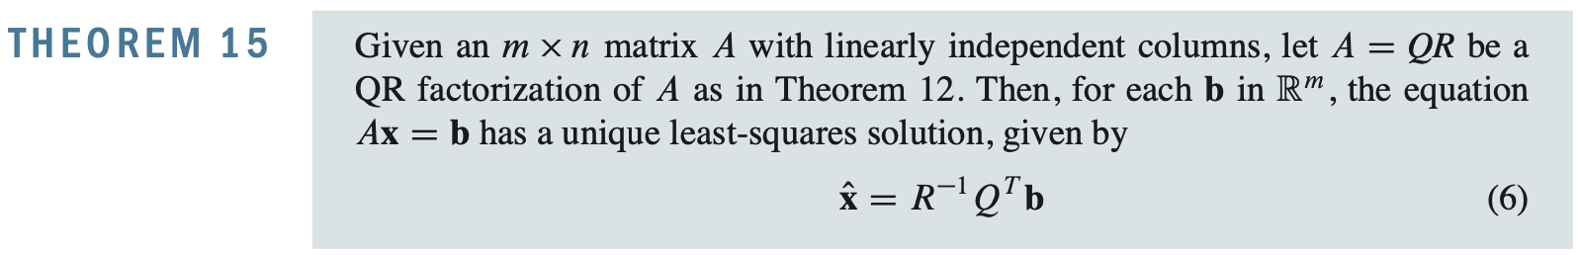
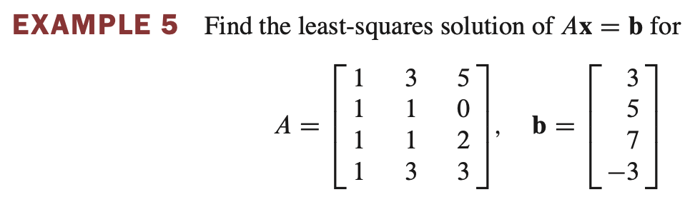
Least-Squares Problems

Slide 32
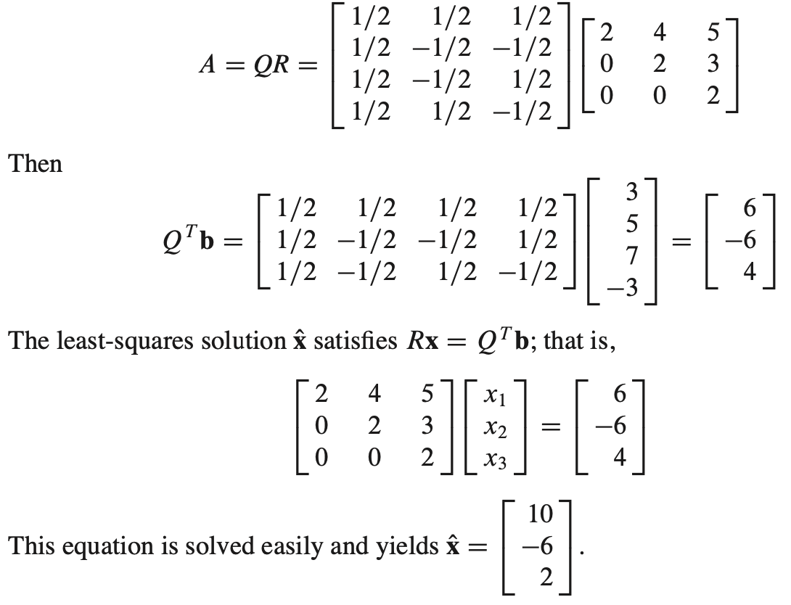
Least-Squares Problems
Solution

Slide 33
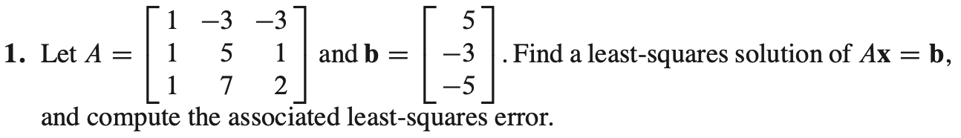
Latihan

Slide 34
Terimakasih

